Slide 1


Slide 2
7.1 Magic Square 3X3 (Paper-Pencil Game)
Aims:
Participants should be taught to count reliably up to 15.
They understand that the numbers have to be arranged in different combinations, but the sums in each row (horizontal, longitudinal and oblique must be the same.
They know how to count, add and find combinations with the numbers from 0 to 9 to find the magic number 15.

Slide 3
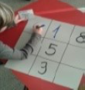
7.1 Magic Square 3X3 (Paper-Pencil Game)
Comments on the Course:
Lesson from 3 to 20 Minutes, give to each student a paper on which you have printed a magic square 3X3 with empty boxes.
You can start the lesson talking about the legend of Lo Shu.
Explain the game “Magic Square 3X3 ”
Explain to the students that they must insert the single digit numbers from 1 to 9 in the square, in the horizontal, longitudinal and oblique lines, that give the same number, the magic number, as the result. Finally they will discover the magic number after having done some additions.
The participants learn to count up to 15 and discover that in a 3x3 magic square, the magic number is given by the number in the center of the square, multiplied by 3
On the worksheet they fill the square with numbers.
They learn all the possible combinations to get it, adding the numbers in the rows, lines and diagonals.
When the students understand the rule, they can build other magic squares by themselves.

Slide 4
7.1 Magic Square 3X3 (Paper-Pencil Game)
Hints
If the participants cannot read, the teacher has to guide them.
If participants have difficulties to count, you have to train – you need more time or you can split the group.
If participants have difficulties to write numbers, you have to divide the lesson into two lessons: First lesson: play and count, second lesson: play and write numbers.
Following lesson: Look for another game, in which the participants have to count up to 9.

Slide 6
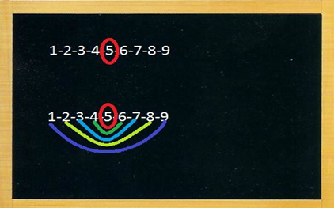
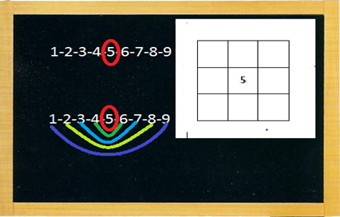
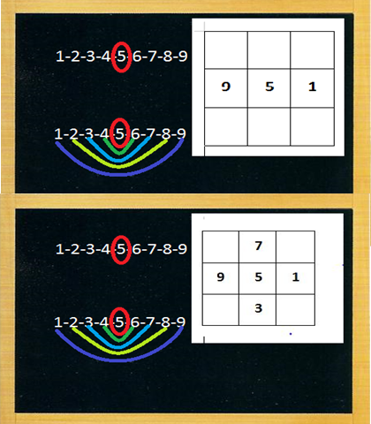
7.1 Magic Square 3X3 (Paper-Pencil Game)
To start the game Magic Square write on the blackboard the numbers from 1 to 9 and give a worksheet with the square to the students .
Which is the number in the middle?
Circle it in red
Look at the numbers on the left and right side of the 5 and match pairs: one on the left, with one on the right, from the center to the external
Which other numbers can you write on the right and the left? Which are the available couples?
Let’s try with the external couple 1 and 9. Make the addition: 1+5+9 is …
Try now in vertical. You can choose among the pairs 6 and 4, 7 and 3 or 8 and 2; choose the numbers on the right and on the left of n.5 from the center towards the border. Then choose one pair whose sum is 10.
Complete the square working in the diagonal and using the other pair of numbers. All lines have to add up to 15 in any direction.

Slide 7
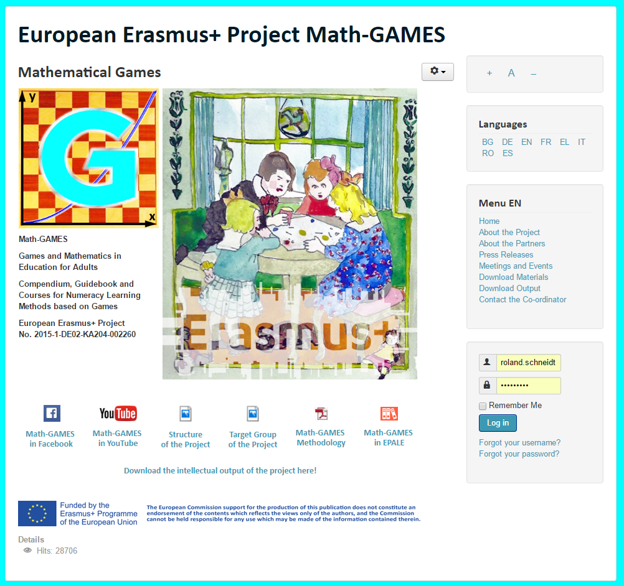
The result is: Play Games and and learn Mathematics more easily.
Our Project-Website will help you: www.math-games.eu

